Slide 1
Introduction to Linux
Jelena Karapetrovic

Slide 2
Objectives
Apply Linux directory structure
Use basic Linux commands
Use text editors: vi and nano

Slide 3
Why Linux OS?
AT&T Bell labs 1960’s
Cost
Security
Freedom
Software
Applicable

Slide 4
Log In
Secure Shell (SSH)- secure remote login
Windows- PuTTy (GUI):
login.rc.colorado.edu
Mac- App/Utilities and Linux:
ssh usrname@login.rc.colorado.edu

Slide 5
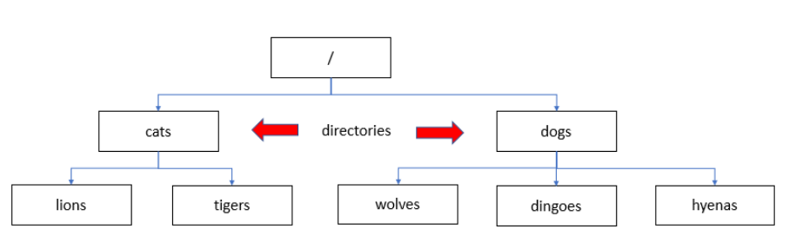
Linux File System- pwd and ls
pwd
ls

Slide 6
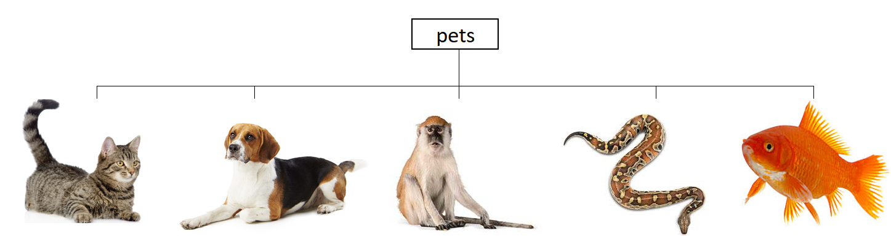
Make Directory- mkdir
pwd
ls
mkdir

Slide 7
Change Directory- Below- cd
pwd
ls
mkdir
cd

Slide 8
Make Directory- mkdir
pwd
ls
mkdir
cd

Slide 9
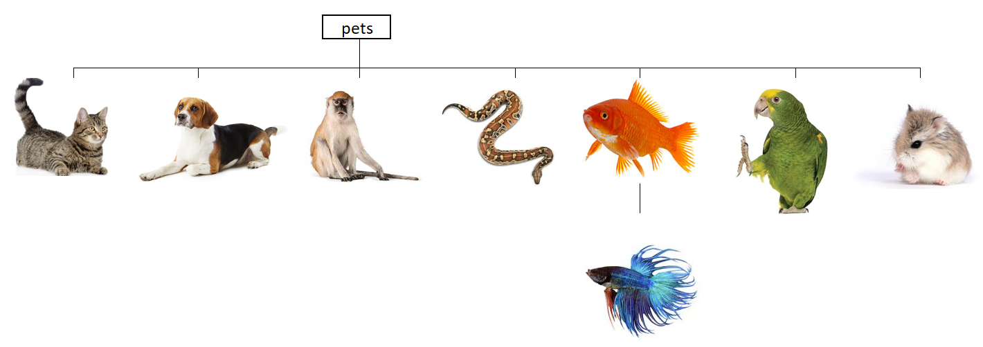
To Do- Make Directory
pwd
ls
mkdir
cd

Slide 10
Change Directory- Above- cd ..
pwd
ls
mkdir
cd
cd ..

Slide 11
Remove Directory- rmdir and rm -r
pwd
ls
mkdir
cd
cd ..
rmdir
rm -r

Slide 12
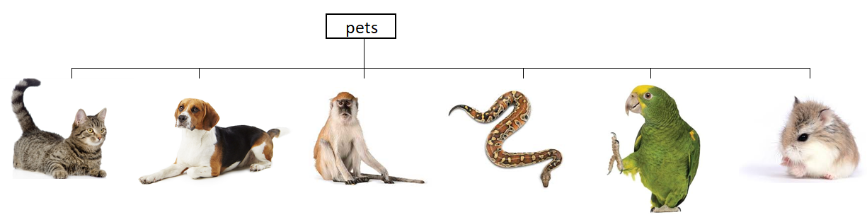
Our tree
pwd
ls
mkdir
cd
cd ..
rmdir
rm -r

Slide 13
Text Editor- nano
pwd
ls
mkdir
cd
cd ..
rmdir
rm –r
nano

Slide 14
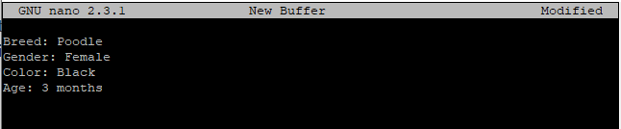
Using nano
pwd
ls
mkdir
cd
cd ..
rmdir
rm –r
nano
http://staffwww.fullcoll.edu/sedwards/Nano/NanoKeyboardCommands.html
poodle1
Ctrl
G
help
Ctrl
X
exit

Slide 15
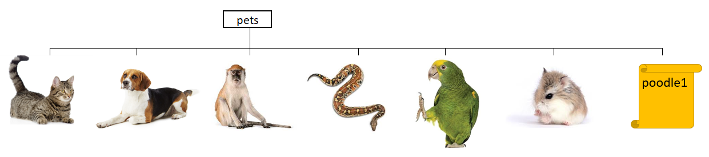
Our tree
pwd
ls
mkdir
cd
cd ..
rmdir
rm –r
nano

Slide 16
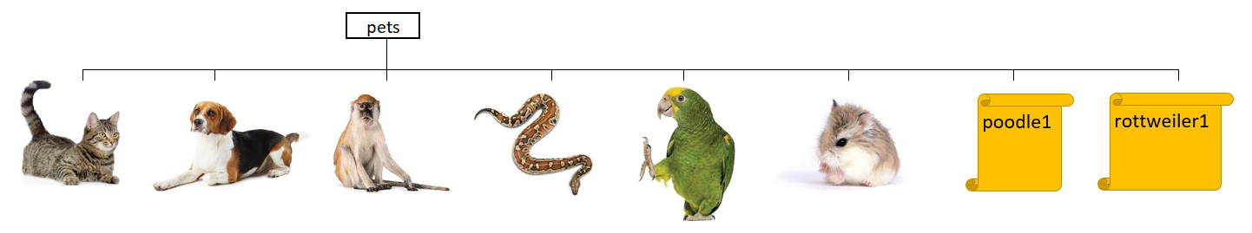
To Do- Create a file
pwd
ls
mkdir
cd
cd ..
rmdir
rm –r
nano
Breed: rottweiler
Gender: Male
Color: Black/brown
Age: 4 months

Slide 17
Move Files- mv
pwd
ls
mkdir
cd
cd ..
rmdir
rm –r
nano
mv
mv <FileName> <DestinationFolder>

Slide 18
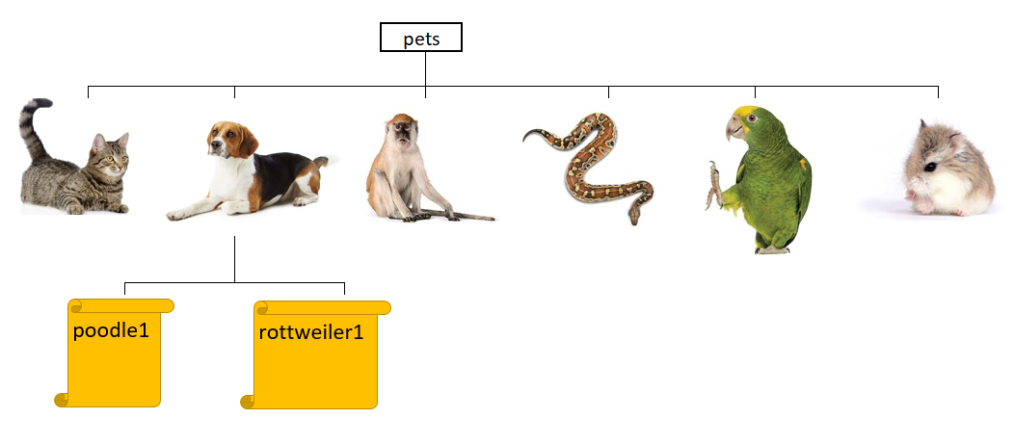
Our tree
pwd
ls
mkdir
cd
cd ..
rmdir
rm –r
nano
mv

Slide 19
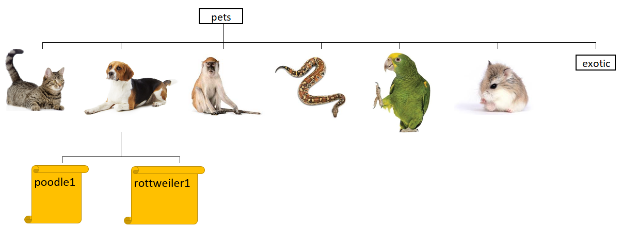
To Do- Make Directory
pwd
ls
mkdir
cd
cd ..
rmdir
rm –r
nano
mv

Slide 20
Move Directory- mv
pwd
ls
mkdir
cd
cd ..
rmdir
rm –r
nano
mv
mv <CurrentDirectory> <NewDirectory>

Slide 21
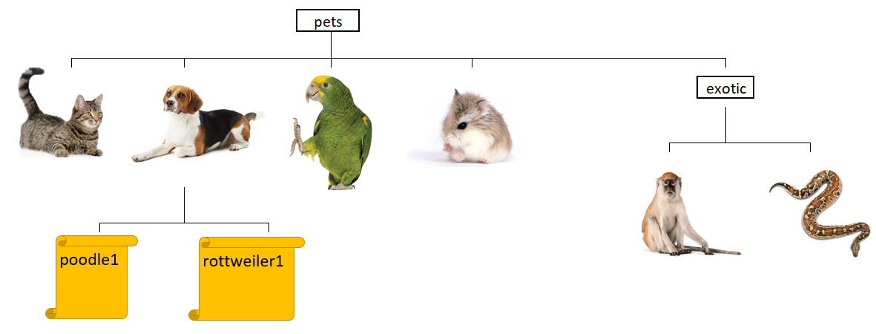
Our tree
pwd
ls
mkdir
cd
cd ..
rmdir
rm –r
nano
mv

Slide 22
Ooops…
pwd
ls
mkdir
cd
cd ..
rmdir
rm –r
nano
mv
poodle1
rottweiler1
Breed: Poodle
Gender: Female
Color: Black
Age: 3 months
Breed: rottweiler
Gender: Male
Color: Black/brown
Age: 4 months

Slide 23
To Do- Change Directory
pwd
ls
mkdir
cd
cd ..
rmdir
rm –r
nano
mv

Slide 24
Text Editor- vim
pwd
ls
mkdir
cd
cd ..
rmdir
rm –r
nano
mv
vi
Modes:
poodle1
i
Insert
Esc
Command
Breed: Poodle
Gender: Female
Color: Black
Born: February 2nd 2019
Vaccination: current
Age: 3 months
:wq Save and exit
https://www.fprintf.net/vimCheatSheet.html

Slide 25
To Do- Edit file in vim
pwd
ls
mkdir
cd
cd ..
rmdir
rm –r
nano
mv
vi
rottweiler1
Breed: rottweiler
Gender: Male
Color: Black/brown
Born: January 10th 2019
Vaccination: current
Age: 4 months

Slide 26
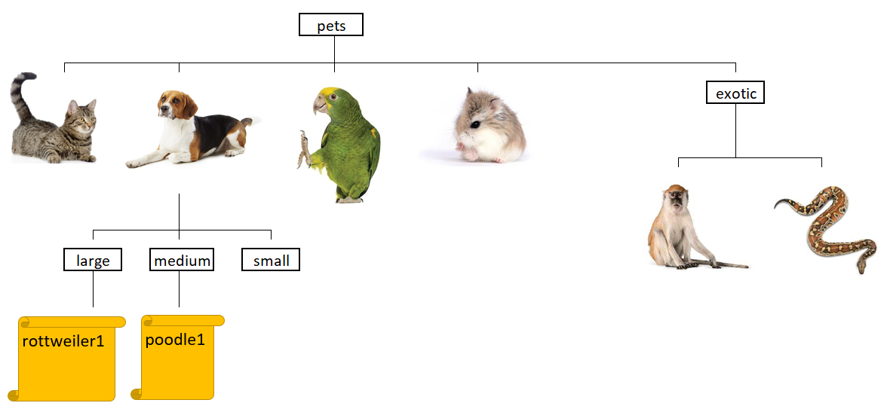
To Do- Make directories and Move files
pwd
ls
mkdir
cd
cd ..
rmdir
rm –r
nano
mv
vi

Slide 27
To Do- Remove file
pwd
ls
mkdir
cd
cd ..
rmdir
rm –r
nano
mv
vi

Slide 28
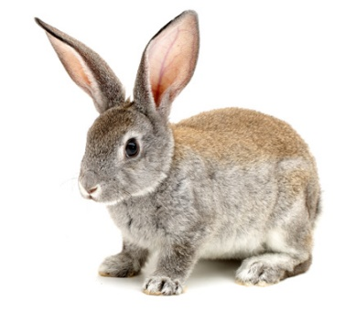
Renaming files- mv
pwd
ls
mkdir
cd
cd ..
rmdir
rm –r
nano
mv
vi
mv <old-Name> <new-Name>

Slide 29
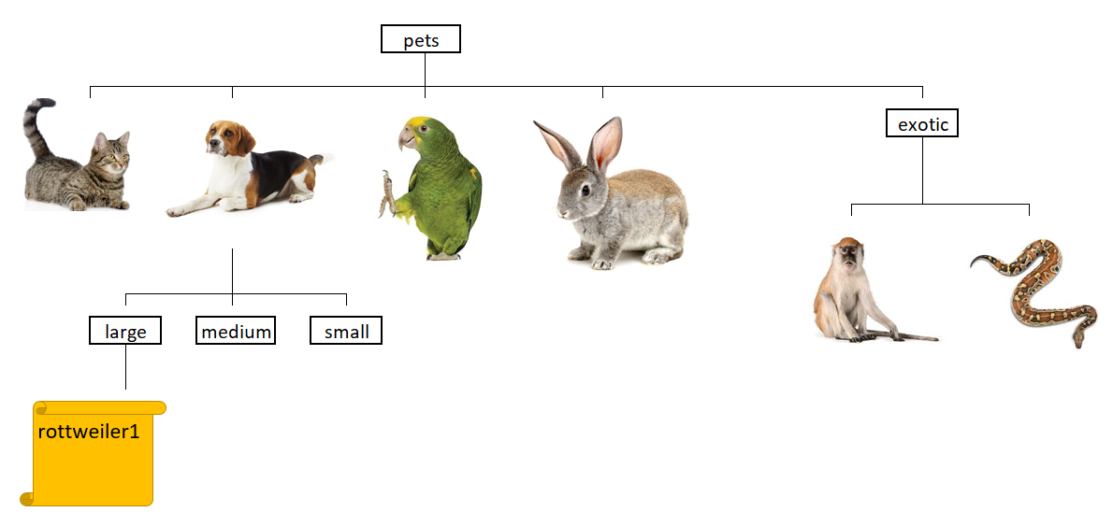
Our tree
pwd
ls
mkdir
cd
cd ..
rmdir
rm –r
nano
mv
vi

Slide 30
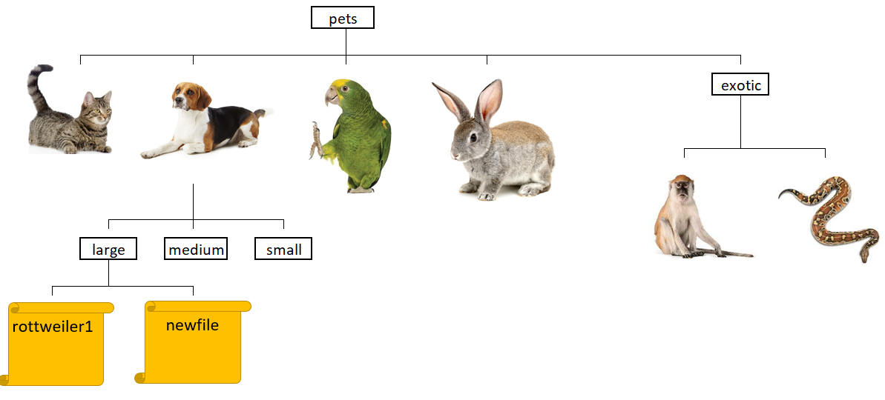
Copy file- cp
pwd
ls
mkdir
cd
cd ..
rmdir
rm –r
nano
mv
vi
cp
cp <File> <File_copy>

Slide 31
Read file- cat
pwd
ls
mkdir
cd
cd ..
rmdir
rm –r
nano
mv
vi
cp
cat

Slide 32

Getting Help- help and man
pwd
ls
mkdir
cd
cd ..
rmdir
rm –r
nano
mv
vi
cp
cat
--help
man
$ mv --help
$ man mv
Navigate
Q
Quit

Slide 33
Question: What does the command ls do when used with the –l option?
pwd
ls
mkdir
cd
cd ..
rmdir
rm –r
nano
mv
vi
cp
cat
--help
man

Slide 34
Conclusion
pwd
ls
mkdir
cd
cd ..
rmdir
rm –r
nano
mv
Vi
cp
cat
--help
man
Directories/files tree:
Navigate (pwd, ls, cd, cd ..)
Make/delete directories (mkdir, rmdir)
Create/Read text files (nano/vi, cat)
Copy/Remove files (cp, rm -r)
Move/rename directories and files (mv)
Get help (--help, man)

